Slide 1
Testing process activities on the TCC Project

Slide 2
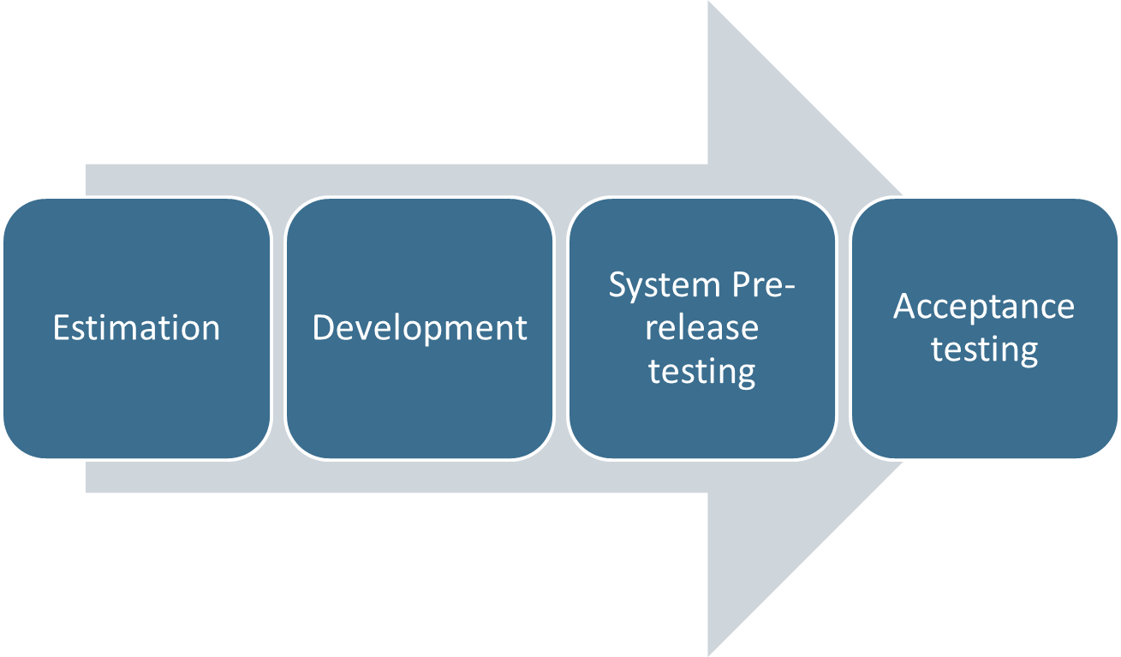
Development workflow and testing process

Slide 3
Testing activities during the estimation phase
Test requirements.
Communication with developers on the specific details.
Creation of the test plan.
Estimation time, required for testing.

Slide 4
Testing activities during the development phase
Testing implemented features.
Testing bugs fixed for the release.
Test design: creating test scripts for the implemented features.
Test design: updating test scripts for the fixed bugs.
Creating J-meter scripts and executing them for the features, that are performance critical.
Exploratory testing.

Slide 5
Test activities during the system testing phase
Regression testing.
System testing.
Release bugs testing.
Bugs opening and verification.
Retesting implemented features and fixed bugs for the release.
Retesting release bugs.
Performance tests execution.
Estimation system readiness for the release.

Slide 6
Test activities during roll out
Sanity check of the system.

